Slide 1
The Internet of Things
Gido ten Cate, Kieran Marriott, Thijs Spapens en Bram van Gils

Slide 2
Inhoud
Overzicht
Protocollen
Voorbeelden
Experiment

Slide 3
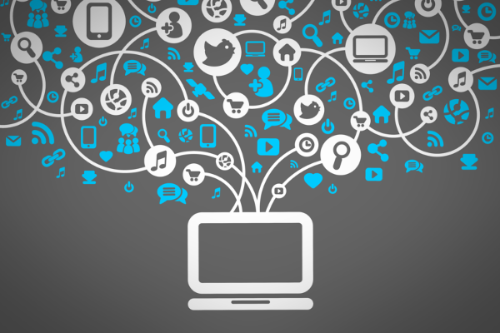
Het Internet
1 Miljoen Exa Bytes
10^24 Bytes
90 % Is al verbonden
Snel Beschikbaar
Opslag via de Cloud

Slide 4
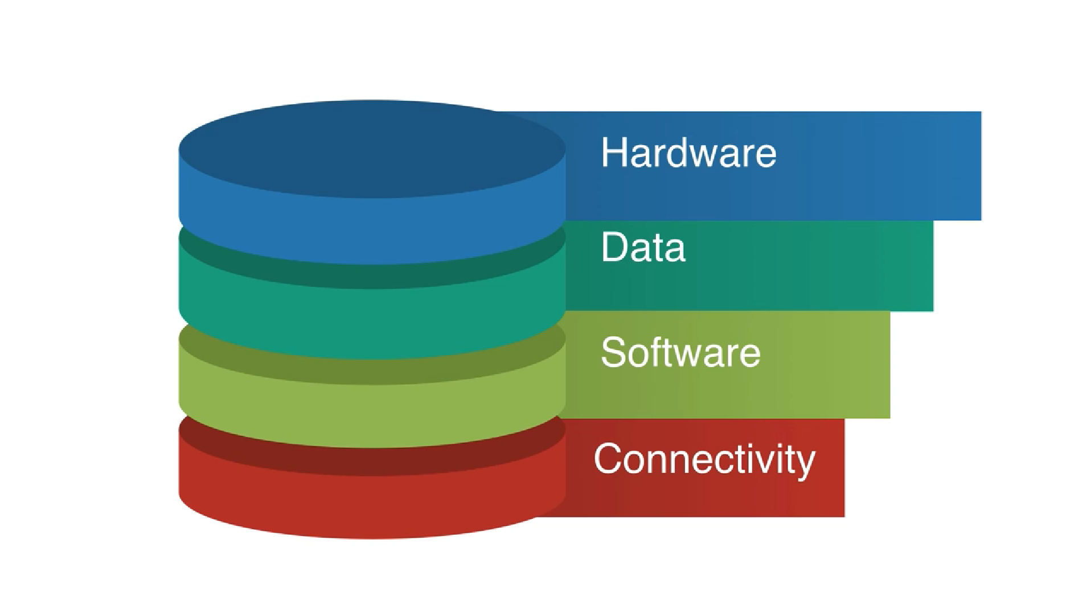
Wat is “The Internet Of things” Bram van Gils
“Een voorgestelde ontwikkeling van het internet, waarbij alledaagse voorwerpen zijn verbonden met het netwerk en gegevens kunnen uitwisselen.”

Slide 5

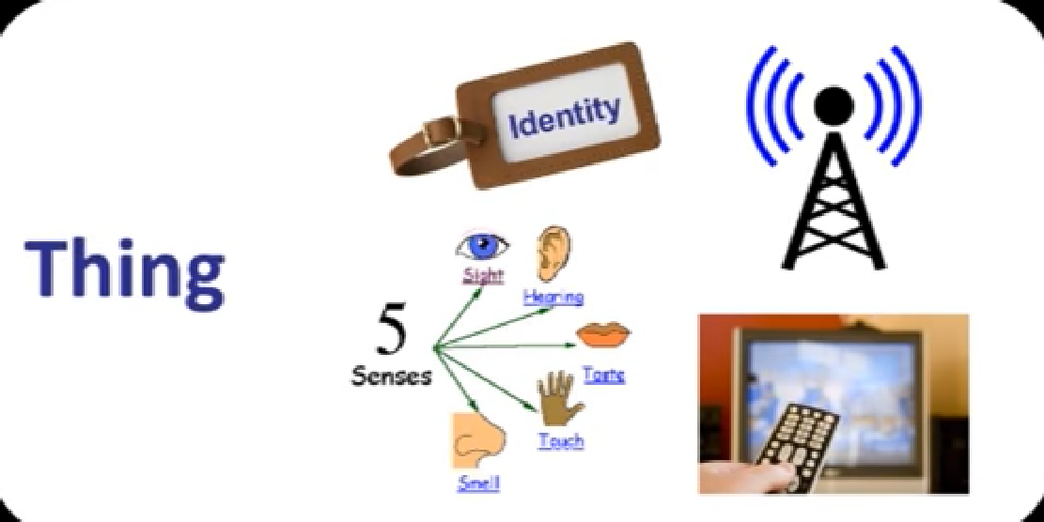
Wat heb ik nodig?
Identiteit
Communicatie
Sensoren
Controle

Slide 6
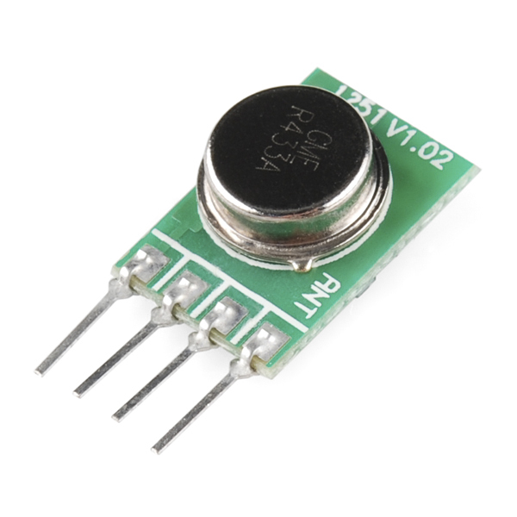
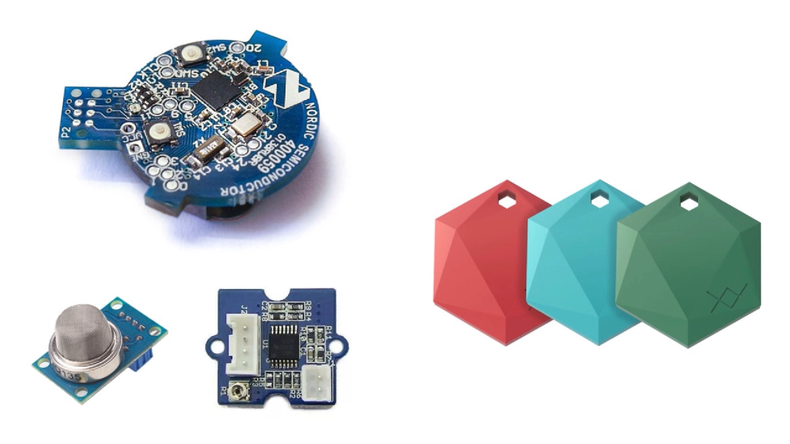
Hoe ziet dit er uit?
Bluetooth Beacon
Air Quality Sensor
Skin Response System
Consumenten versie
RF Transmitter
Notes:
Proximity Marker , Identifier , 4$
Lucht kwaliteit, 6$
Conductiviteit, Stress, Adrenaline, under 10$
Voor geprogameerde software

Slide 7
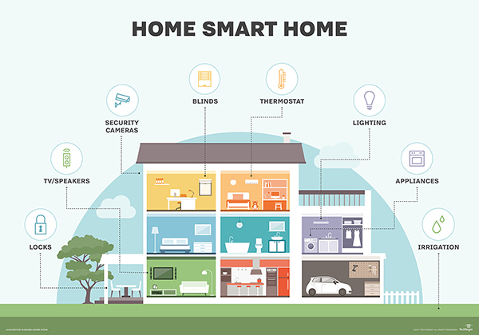
Smart Homes
Extra Overzicht
Extra Controle
Hacking
Diefstal

Slide 8
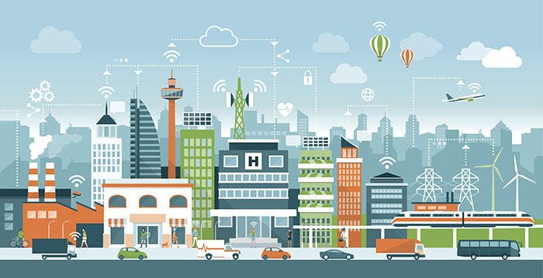
Smart Cities
Verkeers regelingen
Efficientie
Milieu
Inbraken
Profileren

Slide 9
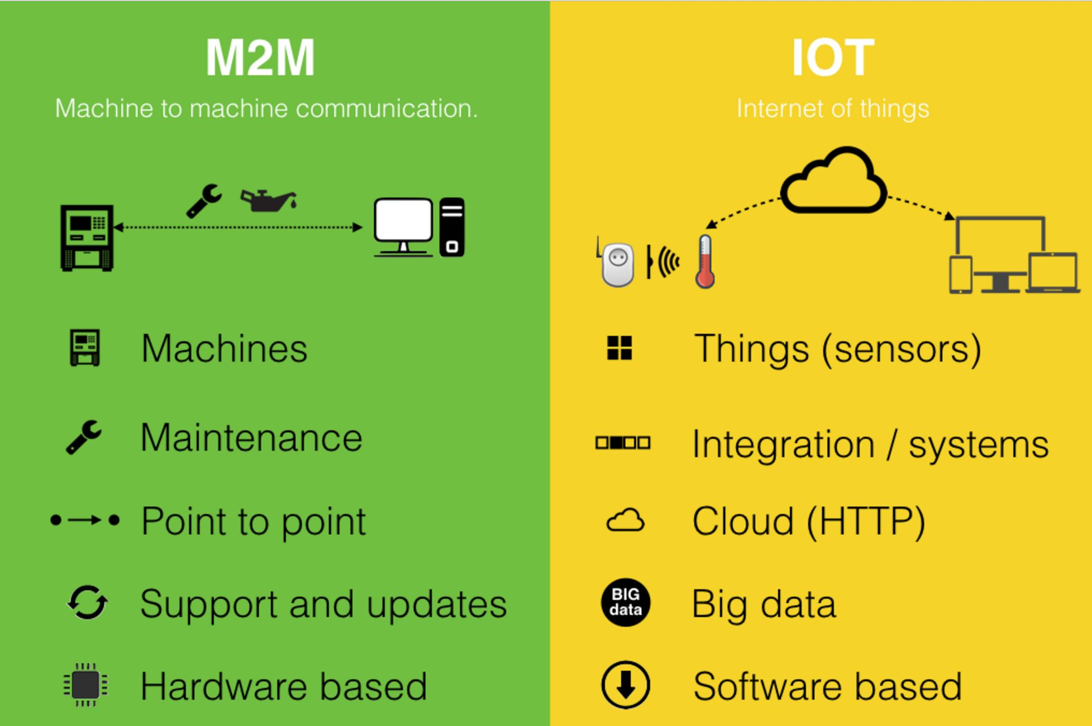
M2m
M2M Gebeurt Lokaal
Compleet Geautomatiseerd
Vooral toegepast in de Industrie
Op kleine schaal

Slide 10
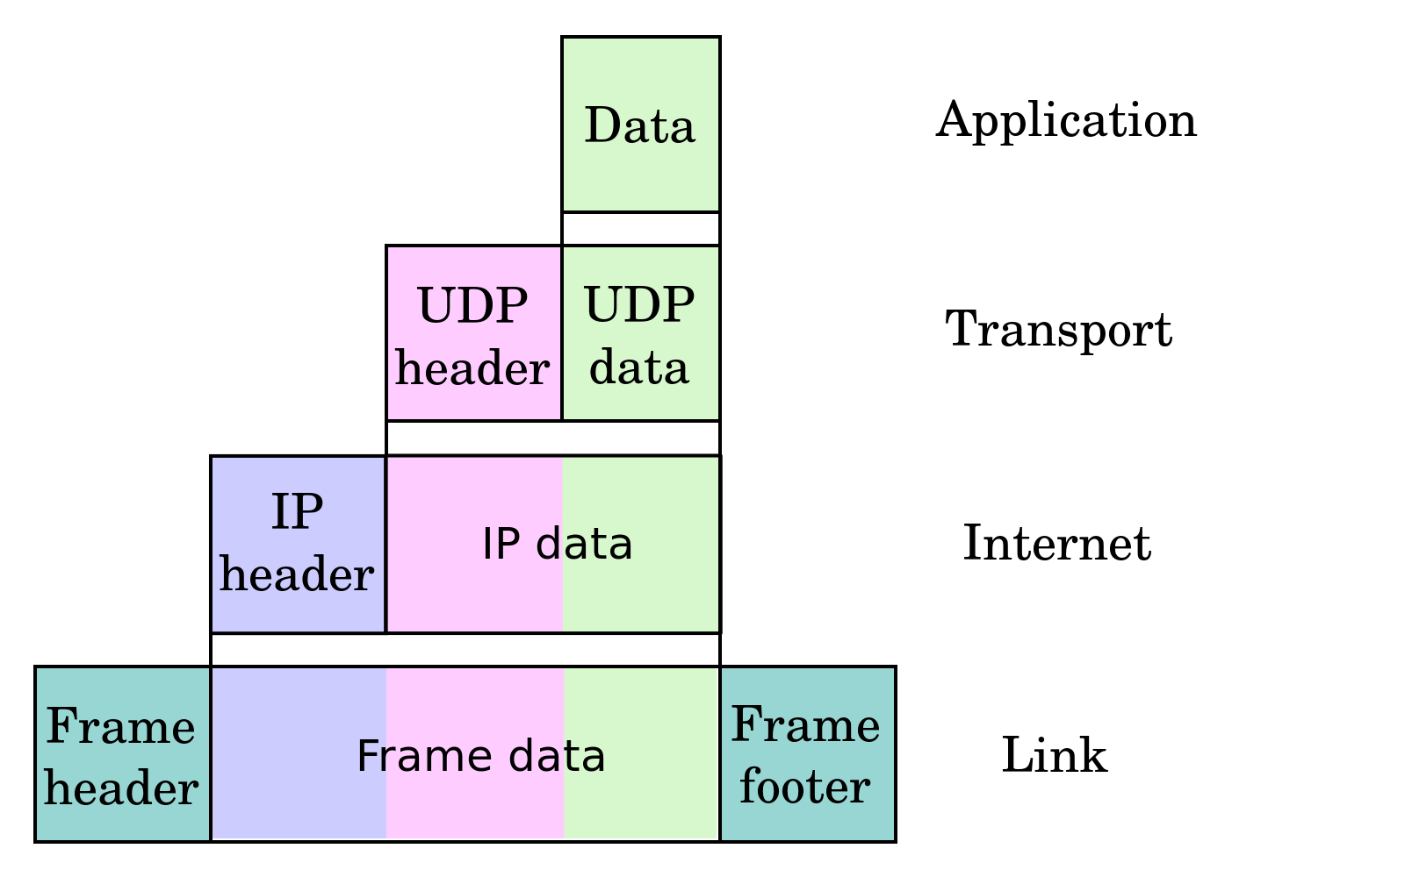
Internet protocol suite
Application layer – HTTP, TLS/SSL, SSH
Transport layer – TCP, UDP
Internet layer – IP (IPv4 & IPv6)
Link layer MAC(Ethernet & DSL)
Notes:
The Internet protocol suite is the conceptual model and set of communications protocols used on the Internet and similar computer networks. It is commonly known as TCP/IP because the foundational protocols in the suite are the Transmission Control Protocol (TCP) and the Internet Protocol (IP).

Slide 11

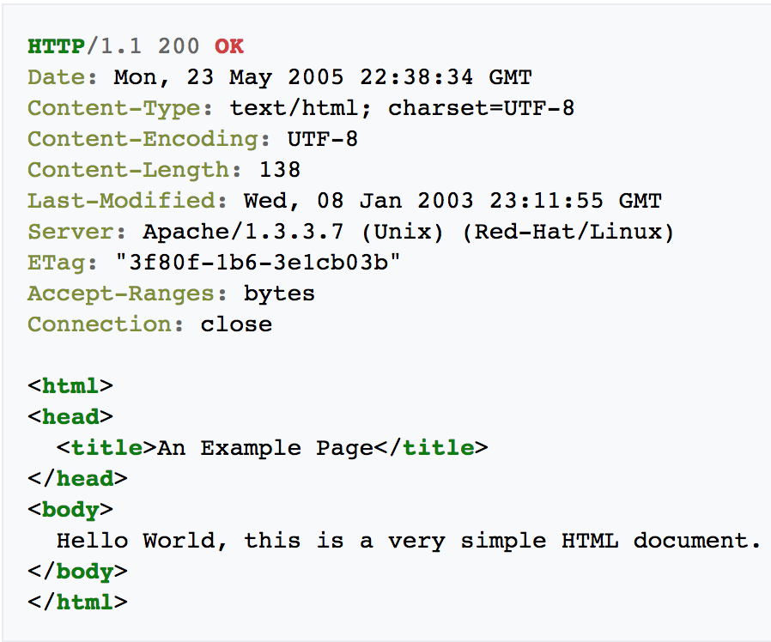
Hypertext transfer protocol (HTTP)
Request
Application layer
Structured Text that uses logical links between nodes containing text
GET, HEAD, POST, DELETE
HTTP2 Data compression of HTTP Headers
Plain text
Server response
Notes:
The Hypertext Transfer Protocol (HTTP) is an application protocol for distributed, collaborative, and hypermedia information systems.^{[1]} HTTP is the foundation of data communication for the World Wide Web.
Hypertext is structured text that uses logical links (hyperlinks) between nodes containing text. HTTP is the protocol to exchange or transfer hypertext.

Slide 12
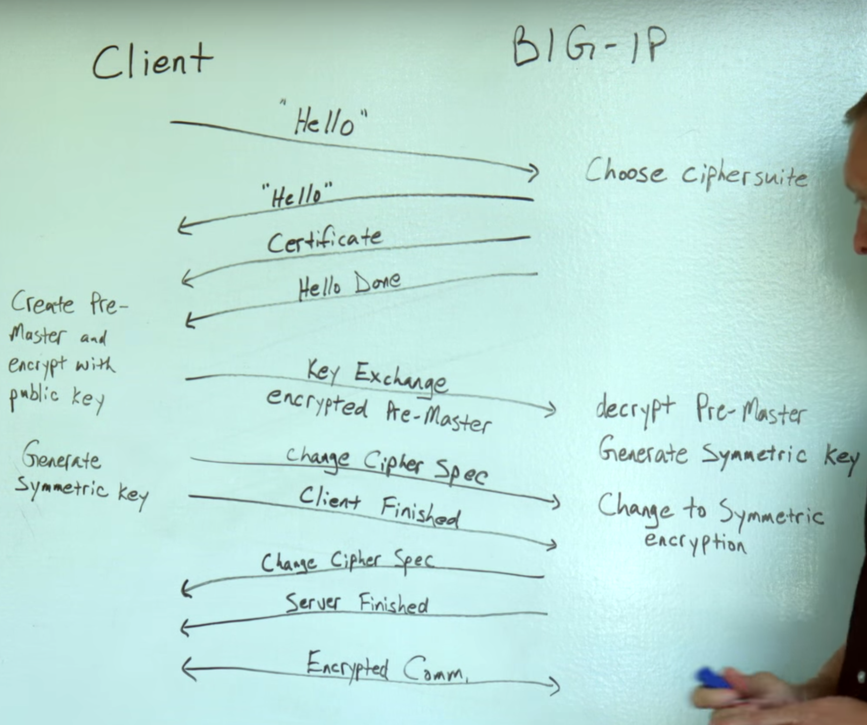
Transport Security Layer (TSL)
TLS Handshake
Application layer
Replaced Secure Sockets Layer (SSL) which was outdated and insecure
TSL handshake
Notes:
Transport Layer Security (TLS) – and its predecessor, Secure Sockets Layer (SSL), which is now prohibited from use by the Internet Engineering Task Force (IETF) – are cryptographic protocols that provide communications security over a computer network.^{[1]} Several versions of the protocols find widespread use in applications such as web browsing, email, Internet faxing, instant messaging, and voice over IP (VoIP). Websites are able to use TLS to secure all communications between their servers and web browsers.

Slide 13
Transmission Control Protocol (TCP)
Transport layer
Provides a reliable, orded, and error-checked stream of data (octets) between applications
Notes:
The Transmission Control Protocol (TCP) is one of the main protocols of the Internet protocol suite. It originated in the initial network implementation in which it complemented the Internet Protocol (IP). Therefore, the entire suite is commonly referred to as TCP/IP. TCP provides reliable, ordered, and error-checked delivery of a stream of octets (bytes) between applications running on hosts communicating by an IP network. Major Internet applications such as the World Wide Web, email, remote administration, and file transfer rely on TCP. Applications that do not require reliable data stream service may use the User Datagram Protocol (UDP), which provides a connectionless datagramservice that emphasizes reduced latency over reliability.

Slide 14
Internet Protocol (IP)
Internet layer
Delivers packets from the host to the destination based solely on the ip addresses in the packet headers
IP Header contains (IP address and other metadata)
Notes:
The Internet Protocol (IP) is the principal communications protocol in the Internet protocol suite for relaying packets across network boundaries. Its routing function enables internetworking, and essentially establishes the Internet.
IP has the task of delivering packets from the source host to the destination host solely based on the IP addresses in the packet headers. For this purpose, IP defines packet structures that encapsulate the data to be delivered. It also defines addressing methods that are used to label the datagram with source and destination information.
Historically, IP was the connectionless datagram service in the original Transmission Control Program introduced by Vint Cerf and Bob Kahn in 1974; the other being the connection-oriented Transmission Control Protocol (TCP). The Internet protocol suite is therefore often referred to as TCP/IP.
The first major version of IP, Internet Protocol Version 4 (IPv4), is the dominant protocol of the Internet. Its successor is Internet Protocol Version 6 (IPv6).

Slide 15
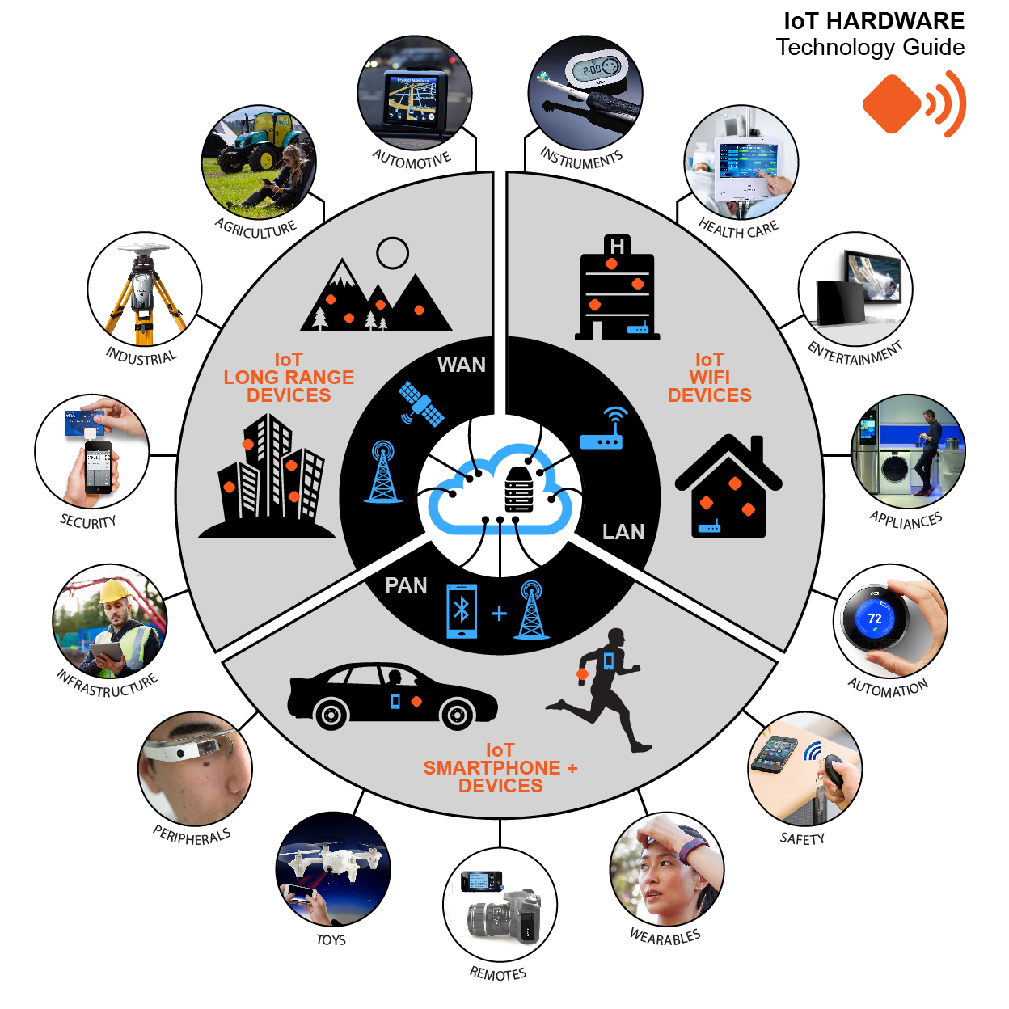
Voorbeelden
Notes:
Agriculture - Vochtigheid niveau, Water niveau, sprinkler automatisering
Security – Pinpas, Camera’s, Brandalarm, inbraak alarm
Peripherals – google glass
Wearables – Smart Watch, Activity tracker
Remotes – met smart phone je TV en muziekspeler besturen
Appliances – smart fridge, stroom verbruik kijken, oven op afstand bedienen
Health Care – hartslag en ademhaling meten en data versturen.
Specs – Bluetooth (lage druk), Router/Modem(middelmatige druk), Servers(Hoge druk)

Slide 16


